Slide 1
What is the Internet?
Mack 2021

Slide 2
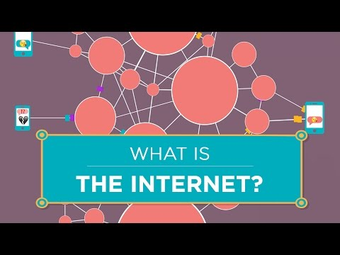
Notes:
What is the internet? Short answer: a distributed packet-switched network. This is the introduction video to the series, "How the Internet Works". Vint Cerf, one of the "fathers of the internet" explains the history of the net and how no one person or organization is really in charge of it.

Slide 3
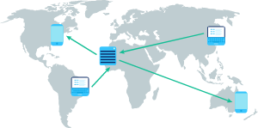
The ingredients of the Internet
The Internet is a global network of computing devices communicating with each other in some way, whether they're sending emails, downloading files, or sharing websites.

Slide 4
The ingredients of the Internet
The Internet is an open network: any computing device can join as long as they follow the rules of the game. In networking, the rules are known as protocols and they define how each device must communicate with each other. The Internet is powered by many layers of protocols.

Slide 5
To create a global network of computing devices, we need:
Wires & wireless: Physical connections between devices, plus protocols for converting electromagnetic signals into binary data.
IP: A protocol that uniquely identify devices using IP addresses and provides a routing strategy to send data to a destination IP address.
TCP/UDP: Protocols that can transport packets of data from one device to another and check for errors along the way.
TLS: A secure protocol for sending encrypted data so that attackers can't view private information.
HTTP & DNS: The protocols powering the World Wide Web, what the browser uses every time you load a webpage.
Notes:
You likely use the Internet every day, but you're probably new to many of those acronyms. In this unit, we'll learn more about each of the technologies underlying the Internet.

Slide 6
The Internet
🤔 What would your life be without the Internet? What would you miss the most? What wouldn't you miss at all? What do you hope the Internet will enable in the future?

Slide 7
Computer networks
The Internet is the world's largest computer network. Let's break that down:
A computer network is any group of interconnected computing devices capable of sending or receiving data. A computing device isn't just a computer—it's any device that can run a program, such as a tablet, phone, or smart sensor.

Slide 8

Building a network
The simplest computer network is two devices:
A network like that only has to worry about a few things, like how to physically connect the two devices and how to send data over the physical connection in a format they both understand.

Slide 9
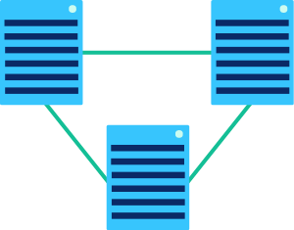
Let's add one more device:
Now there's additional complexity. How can each device know whether incoming data is meant for them or for their neighbor? This simple network will need an addressing scheme.

Slide 10
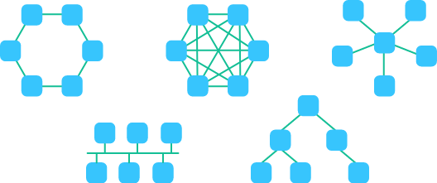
Let's jump to six devices. There are actually many ways we can connect six devices together in a computer network:

Slide 11
Networks
Each of those arrangements is a different network topology, and each topology has its advantages and disadvantages.
Imagine the journey of a piece of data through one of those larger networks. What path will it take? When there are multiple paths, how does it know which path is best?
Once networks become larger, routing strategies become more important. There isn't a big difference between two stops and three stops in a path, but there is a big difference between 20 stops and 300 stops.

Slide 12
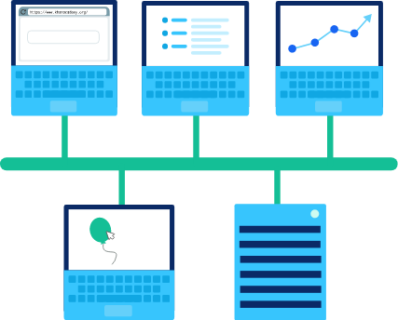
Types of networks
We use different terms to refer to networks based on their size and characteristics. Let's touch on a few of them here.
The most common type of network is the Local area network (LAN), a network that covers a limited area like a house or school.

Slide 13
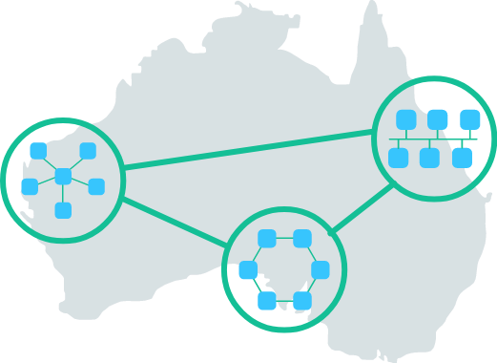
Types of networks
The largest type of network is a Wide Area Network (WAN), a network that extends over a large geographic area and is composed of many, many LANs. Oftentimes, the networks in a WAN can only be connected by leasing telecommunications lines from different companies, since no single company owns all the infrastructure across the wide geographic area.
Notes:
Another type of network is the Data Center Network (DCN), a network used in data centers where data must be exchanged with very little delay.

Slide 14
Check your Understanding
Based on those descriptions, what type of network is the Internet?
Notes:
🍐 This is a Pear Deck Multiple Choice Slide. Your current options are: A: WAN, B: LAN, C: DNC,
🍐 To edit the type of question or choices, go back to the "Ask Students a Question" in the Pear Deck sidebar.
The Internet is considered a WAN, since it is a network of networks, connecting millions of networks of varying sizes across the entire world.
There are other WANs besides the Internet, however. For example, a bank might operate a nationwide WAN of ATM cash dispensers.

Slide 15
Networking protocols
Whenever computing devices are connected together in a network, they need protocols to communicate with each other.
If the devices want to communicate over the Internet, they must use the Internet networking protocols. There are many networks that aren't connected to the Internet that also use the Internet protocols, due to how well designed they are for networking.
However, there are networks that use other protocols that are more suited for their task. Data center networks often opt to use networking protocols that take advantage of the incredibly closely knit architecture of the data center. That enables data centers to more efficiently run intensive algorithms, such as training a deep learning network.
As we go forward in this unit, we will focus specifically on the Internet protocols that power the majority of computer networks. In the future, networks might be using protocols that haven't even been invented yet. Fortunately, the concepts underlying the Internet protocols are relevant to all networked systems.

Slide 16


Slide 17
Physical network connections
The Internet is a network of computers connected to each other. But what does each physical connection look like? It depends on the needs of the connection and the size of the network.

Slide 18
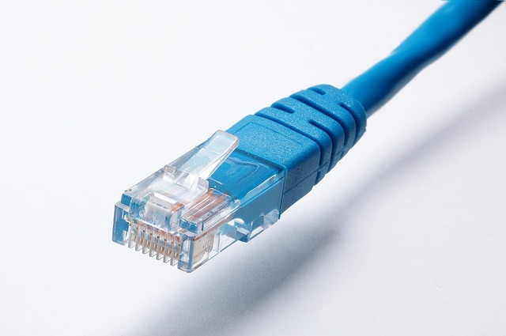
Copper cables
Since the landline telephone system originally used copper wires, the first Internet connections reused that technology and many still use it today.
If you're in a computer lab or near a modem, you can probably find a cable similar to this one:
Notes:
That's a CAT5 cable, a type of twisted pair cable that's designed for use in computer networks.

Slide 19
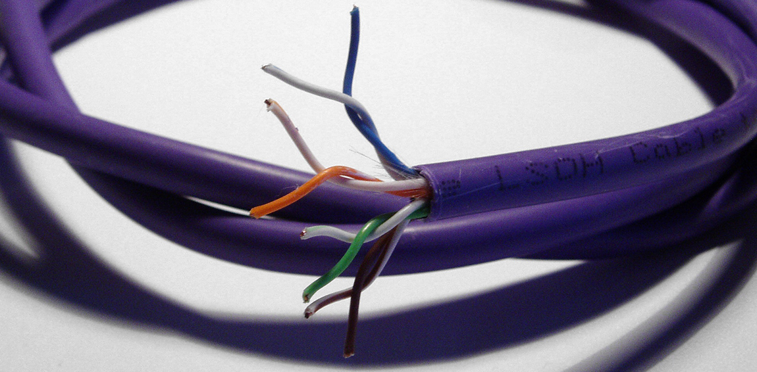
If you were to look inside the cable, you would find four twisted pairs of copper wires:

Slide 20

Cables
Twisted pair cables send data through a network by transmitting pulses of electricity that represent binary data:
To make sure cables are transmitting information in a way that can be understood by the recipient, they follow the Ethernet standards. That's why twisted pair cables are commonly known as Ethernet cables.
They are used both in networks as small as a company office (a LAN) or as large as an entire country (a WAN).

Slide 21
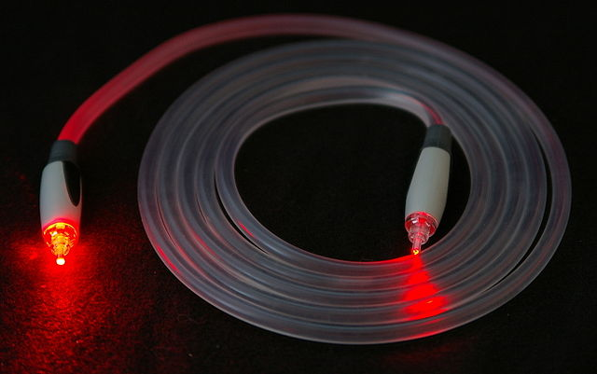
Fiber-optic cables
A fiber-optic cable contains an optical fiber that can carry light (instead of electricity). The fiber is coated with plastic layers and sheathed in a protective tube to protect it from the environment.

Slide 22

Fiber-optic cables communicate by sending pulses of light that represent binary data:
They typically also follow the Ethernet standards to make sure they're sending data in a way that can be commonly understood by any recipient in the network.
Fiber-optic cables are capable of transmitting much more data per second than copper cables. They're often used to connect networks across oceans so that data can travel quickly around the world.
Notes:
As fiber-optic cables become less expensive, they're becoming increasingly common in city-wide networks as well.

Slide 23

Wireless
Wireless connections don't involve any wiring at all—at least at first. A wireless card inside the computer turns binary data into radio waves and transmits them through the air:

Slide 24
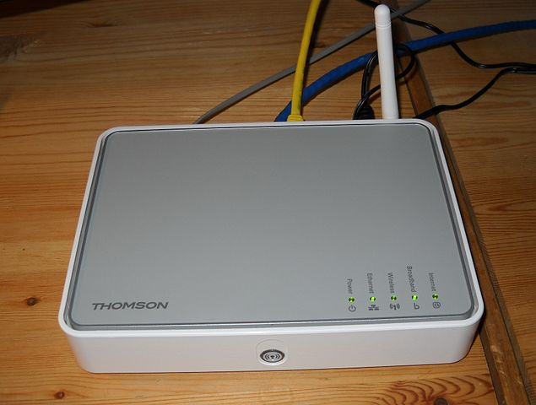
Wireless
Those radio waves can't travel very far: 75-100 feet in a place like an office building that's filled with all sorts of obstacles, or up to 1000 feet in a wide open field.
The waves are hopefully picked up by a wireless access point which converts them from radio waves back into binary data. Wireless access points are connected to the rest of the network using physical wiring, like copper or fiber-optic cables.
Notes:
Wireless connections are limited in how much area they can cover, but they are increasingly commonplace due to the prevalent use of portable computing devices.

Slide 25
All together now
At any given time, our Internet connection might be using a combination of those technologies. Maybe we're using WiFi to connect to our home router, our home router is using twisted pair copper cables to connect to the metropolitan network, and those cables are hopping over fiber to communicate with overseas data centers.
Each technology has both advantages and disadvantages, so we use whatever is best for the job.

Slide 26
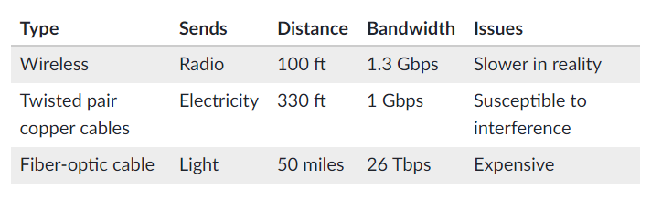
All together now
The data in that table is current as of early 2020. Engineers are constantly discovering new ways to improve network connections, especially when it comes to increasing the bandwidth. We'll learn more about bandwidth in the next article on bit rate, bandwidth, and latency.

Slide 28
Practice

Slide 29
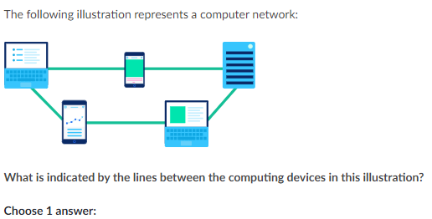
Notes:
🍐 This is a Pear Deck Multiple Choice Slide. Your current options are: A: The computing devices are able to send messages to each other, B: The computing devices are all running the same program, C: The computing devices have access to a central database for storing program data, D: The computing devices are plugged into the same power source,
🍐 To edit the type of question or choices, go back to the "Ask Students a Question" in the Pear Deck sidebar.
A

Slide 30
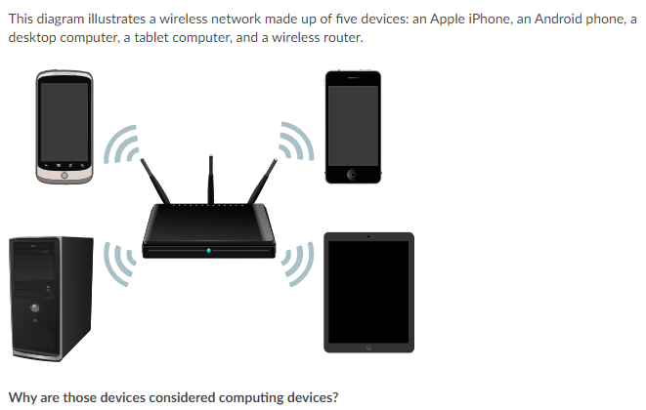
Notes:
🍐 This is a Pear Deck Multiple Choice Slide. Your current options are: A: They are able to respond to user input, B: They are able to send data to other devices on the wireless network, C: They can load webpages in a browser, D: They are capable of running computer programs,
🍐 To edit the type of question or choices, go back to the "Ask Students a Question" in the Pear Deck sidebar.
D

Slide 31
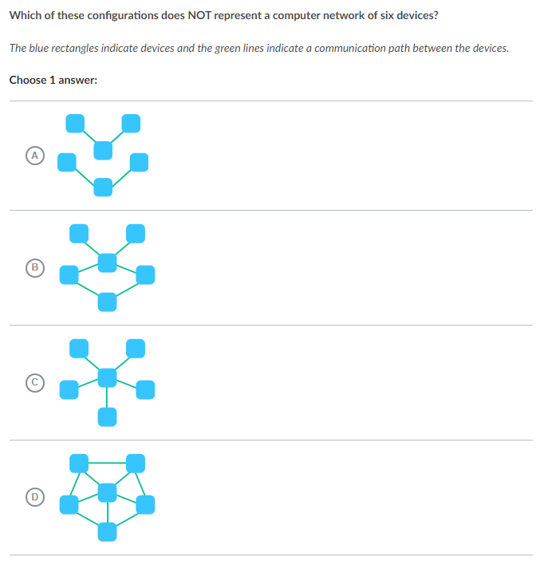
Notes:
🍐 This is a Pear Deck Multiple Choice Slide. Your current options are: A: A, B: B, C: C, D: D,
🍐 To edit the type of question or choices, go back to the "Ask Students a Question" in the Pear Deck sidebar.
A

Slide 32
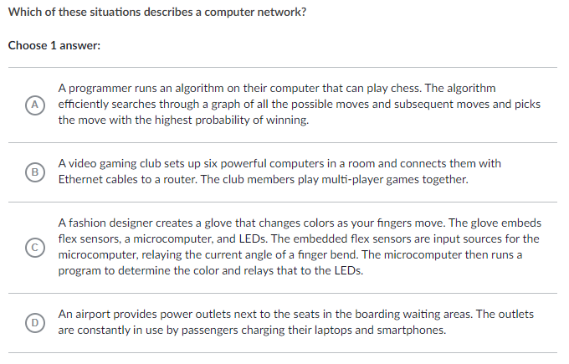
Notes:
🍐 This is a Pear Deck Multiple Choice Slide. Your current options are: A: A, B: B, C: C, D: D,
🍐 To edit the type of question or choices, go back to the "Ask Students a Question" in the Pear Deck sidebar.
B

Slide 33
Bit rate, bandwidth, and latency
All of the computing devices on the Internet are communicating in binary. Whether they are connected via wired or wireless, they are sending electromagnetic signals that represent streams of 1s and 0s.
Let's explore how those bits are sent and how quickly they can be sent.

Slide 34

Sending streams of 1s and 0s
When computers need to internally represent the number 555 (101101101 in binary), they can use three wires to represent the three bits: one wire on, one wire off, one wire on.

Slide 35

Sending streams of 1s and 0s
If a computer wants to send the number 555 to another computer, they can't use as many wires as they want. In fact, they may only have a single wire to send information over. Instead, they can send the number 555 over three time periods: first sending an on pulse (and waiting), then sending nothing (and waiting), then sending an on pulse.

Slide 36

Sending streams of 1s and 0s
As long as the two computers agree on the time period, then they can transfer information to each other, turning binary data into signals and turning the signals back to binary data.
In an electrical connection (such as Ethernet), the signal would be a voltage or current. In an optical connection (such as a fiber-optic cable), the signal would be the intensity of light.
The process of turning binary data into a time-based signal is known as line coding. There are various line coding schemes that can be used based on the needs of the connection.

Slide 37
Bit rate
Network connections can send bits very fast. We measure that speed using the bit rate, the number of bits of data that are sent each second.
The earliest Internet connections were just 757575 bps (bits per second). These days, connections are more often measured in Mbps (megabits per second).

Slide 38
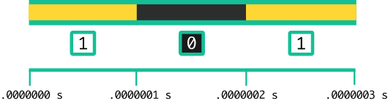
Bit rate
A megabit is huge: 111 million bits! A 101010 Mbps connection transfers data at 101010 million bits per second.
That's one bit every 100100100 nanoseconds (0.00000010.00000010, point, 0000001 seconds).

Slide 39
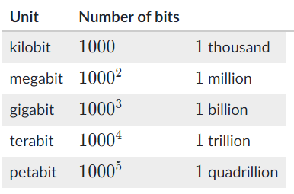
Bit rate
We also measure bit rate in smaller units like kilobits (111 thousand bits) or much bigger units like gigabits (111 billion bits) and even petabits (111 quadrillion bits).

Slide 40
Bandwidth
We use the term bandwidth to describe the maximum bit rate of a system. If a network connection has a bandwidth of 1001 Mbps, that means it can't transfer more than 100 megabits per second. Fortunately, that's still a lot!
Ever heard the term "broadband Internet"? That refers to a connection with a minimum bandwidth of 256 Kbps. That's enough bandwidth for basic Internet use like checking emails and reading websites, but not quite enough for watching online videos. As of 2016, only 40% of people in developing nations have access to even broadband Internet.

Slide 41
Check your Understanding
When I was a kid, our Internet connection had a bandwidth of 56 Kbps (kilobits per second). How many bits per second could that transfer?
Notes:
🍐 This is a Pear Deck Multiple Choice Slide. Your current options are: A: 560 bits per second, B: 5,600 bits per second, C: 56,000 bits per second, D: 560,000 bits per second,
🍐 To edit the type of question or choices, go back to the "Ask Students a Question" in the Pear Deck sidebar.
11 kilobit is 100010001000 bits.
565656 Kbps is 565656 kilobits per second, which is the same as 56 \times 100056×100056, times, 1000 bits per second.
565656 Kbps is 56{,}00056,00056, comma, 000 bits per second.

Slide 42

Latency
Another way to measure the speed of a computer network is latency. You might guess what that means from the word itself: latency measures how late the bits arrive. To put it in more formal terms: latency is the time between the sending of a data message and the receiving of that message, measured in milliseconds.
We typically measure the "round-trip" latency of a request. Let's walk through a real example to see what that means.

Slide 43
Latency
My computer sends a message to the Google server. 30 milliseconds later, Google receives the message. 40 milliseconds later, my computer gets an acknowledgement from Google that it received the message.
That's a total round-trip latency of 70 ms. The latency depends on a number of physical factors: the type of connection from my computer to Google, the distance from my computer to the Google servers, and the congestion in the network (which may mean my request has to wait in line).
There's a major limiting factor to latency: the speed of light. Nothing can move faster than light, not even our very important Internet requests. The speed of light is 111 foot per nanosecond, which means a trip length of at least 30 ms from Los Angeles to Tokyo. We can't do much about the speed of light, but we can decrease latency by reducing congestion and improving our physical connections.

Slide 44
Internet speed
Speed is a combination of bandwidth and latency. Computers split up messages into packets, and they can't send another message until the first packet is received. Even if a computer is on a connection with high bandwidth, its speed of sending and receiving messages will still be limited by the latency of the connection.
You can measure the current speed of a network using an Internet speed test: a website that downloads and uploads data while tracking how quickly the data is transferred.

Slide 45

Here are the results from an Internet speed test from my home laptop:
The latency (also called the ping rate) was just 181818 ms. That's fast enough for most multi-player online games.
The download bitrate is 39 Mbps and the upload bit rate is 5.85, point, 85 Mbps, significantly less. Actually, that's expected. Internet providers often support a much faster download speed than upload speed, because Internet users spend much more time downloading data (reading articles, watching movies) than uploading data (writing blog posts, submitting forms).

Slide 46
🔍 What's the speed of your Internet connection? What bandwidth does your Internet provider promise? What type of physical connection are you using? This is a great opportunity to get a deeper understanding of the physical infrastructure you use every day.
Notes:
🍐 This is a Pear Deck Text Slide
🍐 To edit the type of question, go back to the "Ask Students a Question" in the Pear Deck sidebar.

Slide 48
Practice

Slide 49

Notes:
🍐 This is a Pear Deck Multiple Choice Slide. Your current options are: A: Sign up now for a bandwidth of 50 seconds/megabit!, B: Sign up now for a bandwidth of 50 megabits!, C: Sign up now for a bandwidth of 50 megabits/second!, D: Sign up now for a bandwidth of 50 milliseconds!,
🍐 To edit the type of question or choices, go back to the "Ask Students a Question" in the Pear Deck sidebar.
C

Slide 50
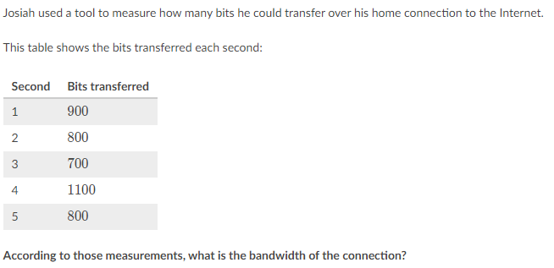
Notes:
🍐 This is a Pear Deck Multiple Choice Slide. Your current options are: A: 900 bits/s, B: 700 bits/s, C: 1100 bits/s, D: 800 bits/s,
🍐 To edit the type of question or choices, go back to the "Ask Students a Question" in the Pear Deck sidebar.
C

Slide 51
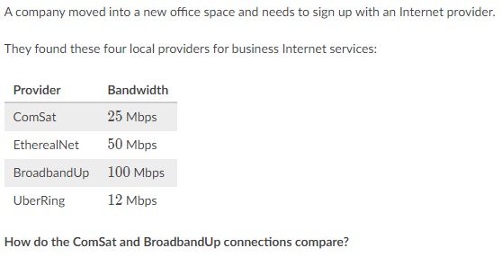
Notes:
🍐 This is a Pear Deck Multiple Choice Slide. Your current options are: A: The ComSat connection can transfer two times the amount of data per second, B: The ComSat connection can transfer four times the amount of data per second., C: The BroadbandUp connection can transfer two times the amount of data per second, D: The BroadbandUp connection can transfer four times the amount of data per second, E: The same amount of data per second can be transferred over both connections,
🍐 To edit the type of question or choices, go back to the "Ask Students a Question" in the Pear Deck sidebar.
D

Slide 52
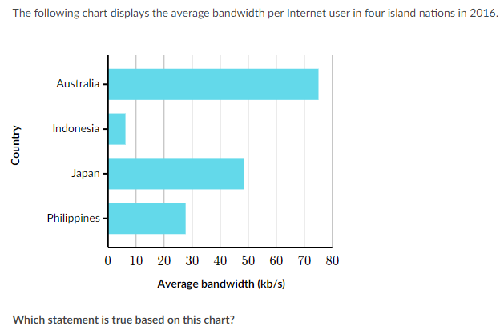
Notes:
🍐 This is a Pear Deck Multiple Choice Slide. Your current options are: A: The average Internet user in Australia will have to wait longer to download a large file than the average user in Japan., B: The average Internet user in the Philippines must wait longer to receive packets over the Internet than the average user in Indonesia., C: The average Internet connection in Japan connects to more routers than the average connection in Indonesia., D: The average Internet connection in Japan can transfer more bits per second than the average connection in the Philippines.,
🍐 To edit the type of question or choices, go back to the "Ask Students a Question" in the Pear Deck sidebar.
D

